Slide 1
Olalekan Salako
Nigeria COVID-19 Data Analysis Using Python

Slide 2
Introduction
- Coronavirus disease (COVID-19) is an infectious disease caused by a newly discovered coronavirus, and it has affected major parts of the world. Nigeria, a West-African country, has also been affected by the COVID-19 pandemic after recording its first case on 27th February 2020.
- Nigeria is a country with 37 states - Federal Capital Territory included- and a fast-growing economic environment with about 200 million citizens. COVID-19 has affected several country activities as the country steadily progressed from its first case, to shutting down major airports, state-wide lockdown, curfews, and reviving its economy.
- The major aim of writing this report is to evaluate the negative impact of covid-19 on Nigeria's economy and how the country managed to survive it.

Slide 3
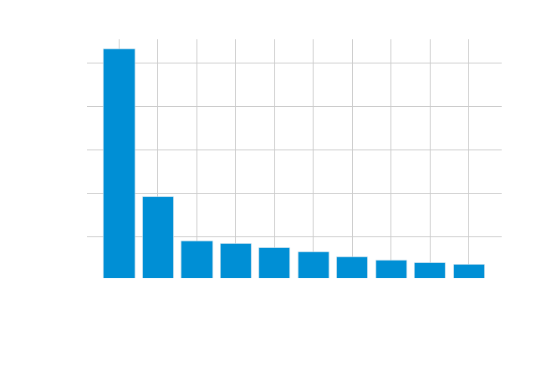
Lagos State had the highest Laboratory Confirmed cases of covid-19

Slide 4
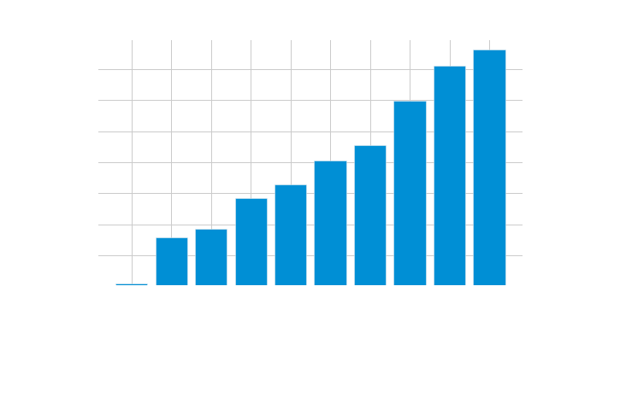
- Kogi State recorded lowest Laboratory confirmed cases of covid-19

Slide 5
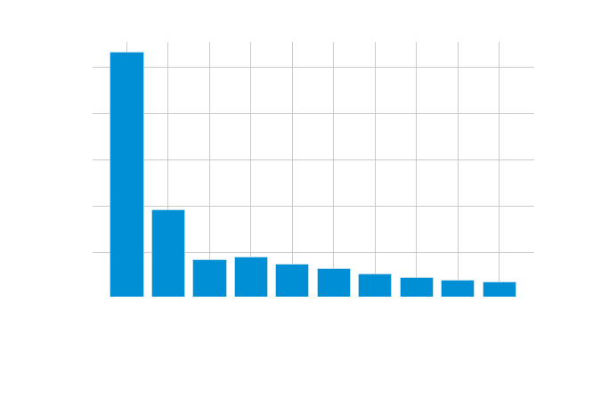
- Lagos State had the highest Number of Discharged Cases

Slide 6
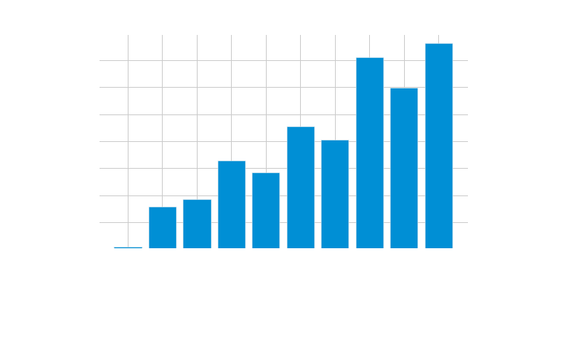
- Kogi State had the lowest No of Discharged Cases

Slide 7
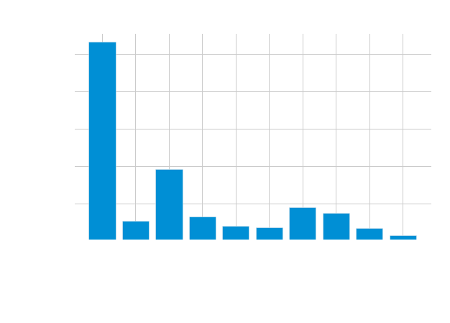
- Lagos State recorded the highest No of Death Cases

Slide 8
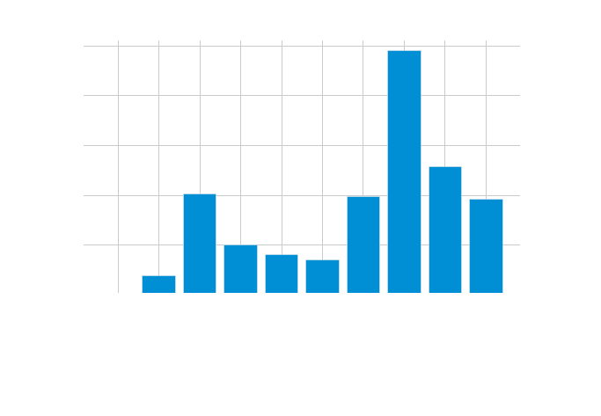
- Kogi State recorded the lowest No of Death Cases

Slide 9
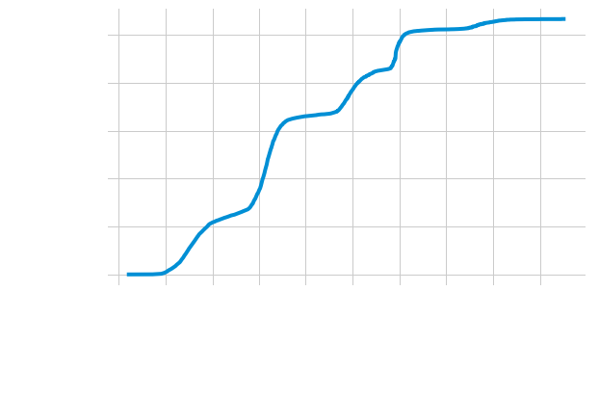
- The rate of daily confirmed cases increases as date progresses from January 2020 to May 2023.

Slide 10
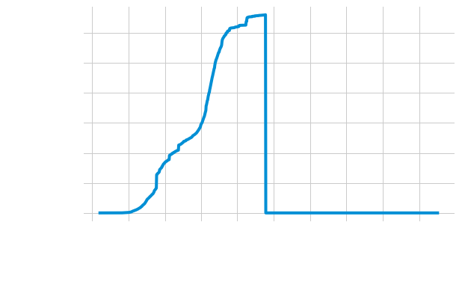
- The rate of daily recovered cases of covid-19 increases from January 2020 until September 2021 It later dropped sharply to the lowest level and maintained that level till May 2023.

Slide 11
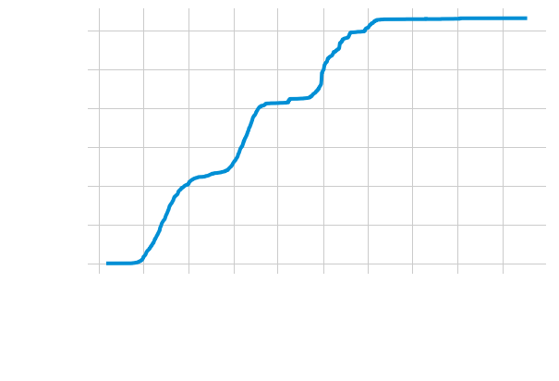
- The daily death cases increases gradually from January 2020 until January 2022. This level was maintained till May 2023.

Slide 12
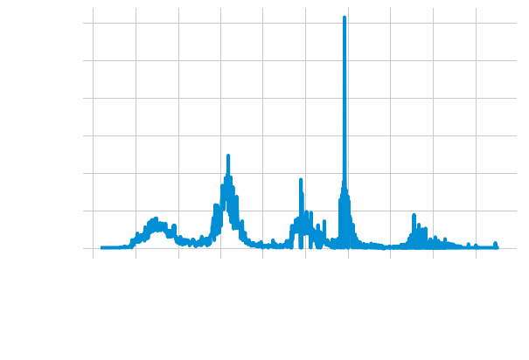
- The Daily Infection Rate was over 6000 cases. And this happened in January 2022.

Slide 13
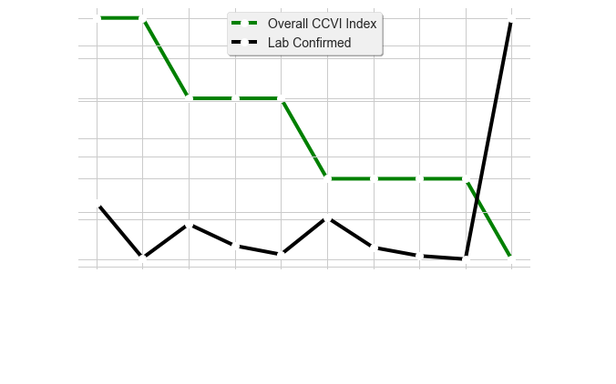
As the Overall Community Vulnerability Index (CCVI) decreases, Laboratory Confirmed Cases surge.

Slide 14
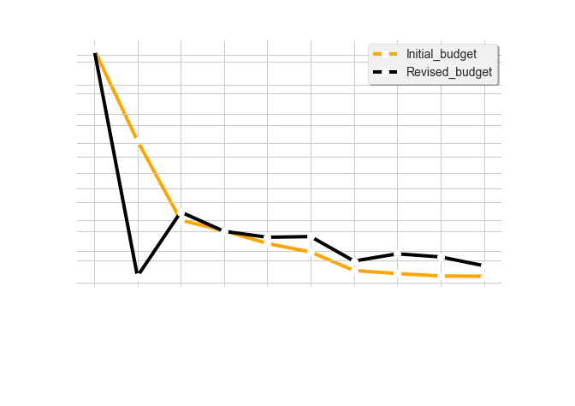
- The initial budgets of States were revised and reduced due to the effects of covid-19. And this had adverse effects on the economy.

Slide 15
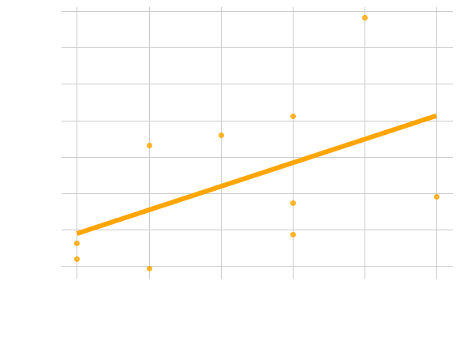
As Population density increases(the denser the population density), more people were infected with covid-19 virus

Slide 16
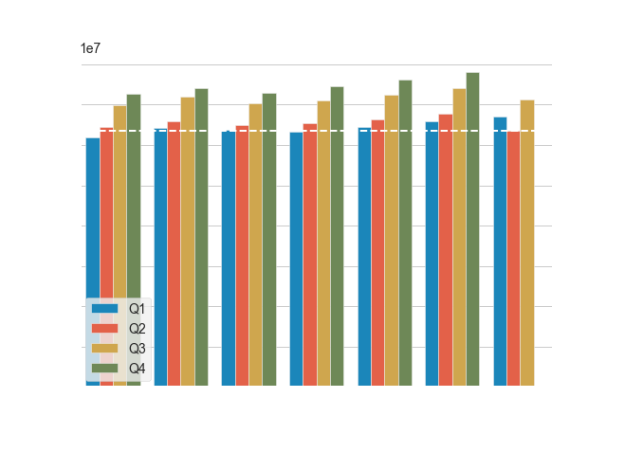
The Real GDP Values were healthy before Q2 2020. And there was no Real GDP Values at all in Q4 2020.

Slide 17
Conclusion:
All the datasets obtained from different sources analyzed for this project pointed to Lagos State as the one seriously hit by covid-19. And since it is the powerhouse of Nigeria's economy, many business activities paralyzed due to lockdown of various agencies such as airports, seaports, markets, schools, federal and state government parastatals etc.

